Slide 1
TERMS AND CONDITIONS
These PowerPoint slides are a tool for lecturers, and as such:
YOU MAY add content to the slides, delete content from the slides, print out the slides, and save the slides onto your computer or server.
YOU MAY NOT resell, reproduce or redistribute the content in any form whatsoever, without prior written permission from the copyright holder.
© Troupant Publishers (Pty) Ltd, 2016
Selected images used under licence from Shutterstock.com

Slide 2
Engineering Technology
NQF Level 2

Slide 3
Engineering power tools
Topic 2

Slide 4
Selecting engineering power tools
Module 2

Slide 5
Selecting engineering power tools
Unit 2.1

Slide 6
Selecting engineering power tools
Appropriate tools for the job.
In good condition before use.
Inspect tools for damage.
Must conform to documents – worksite rules, operating instructions, maintenance schedules, health and safety requirements.

Slide 7
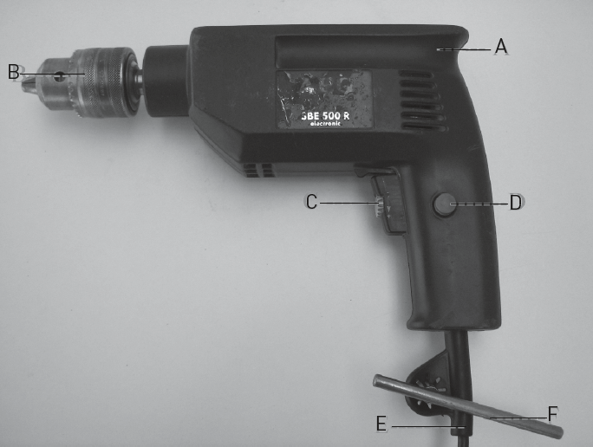
Portable electric drilling machines
Figure 2.1: Parts of a drilling machine

Slide 8
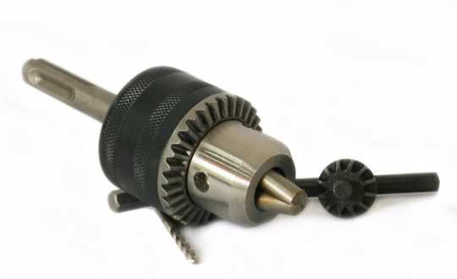
Portable electric drilling machines
Figure 2.2: A chuck with its key

Slide 9
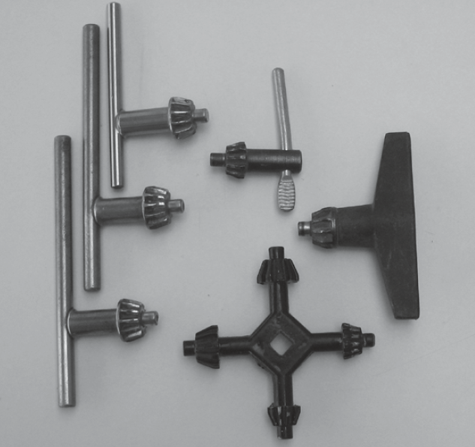
Portable electric drilling machines
Figure 2.3: Chuck keys

Slide 10
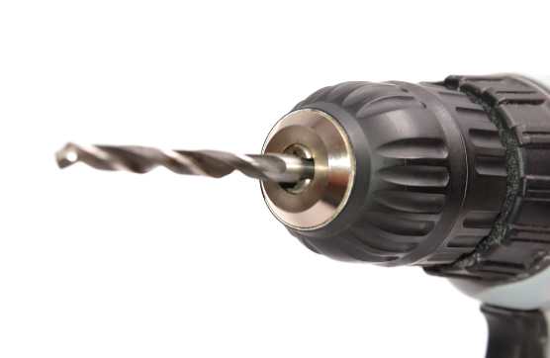
Portable electric drilling machines
Figure 2.4: A keyless chuck

Slide 11
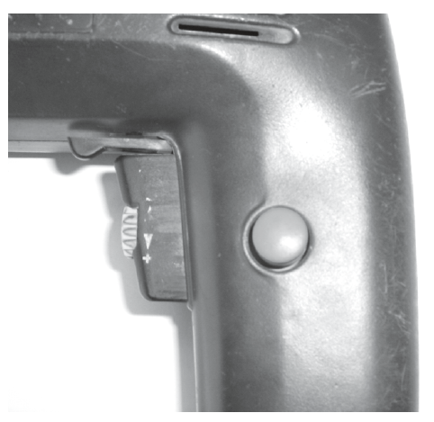
Portable electric drilling machines
Figure 2.5: The trigger mechanism

Slide 12
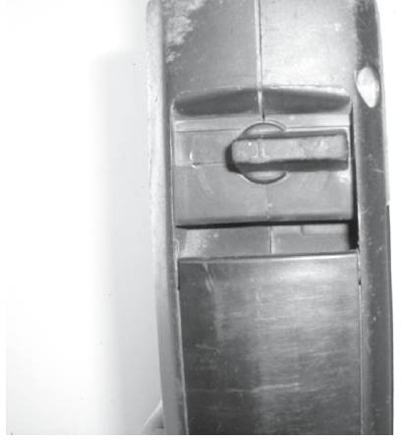
Portable electric drilling machines
Figure 2.6: Hammer action switch

Slide 13
VIDEO: Electric drilling machine

Slide 14
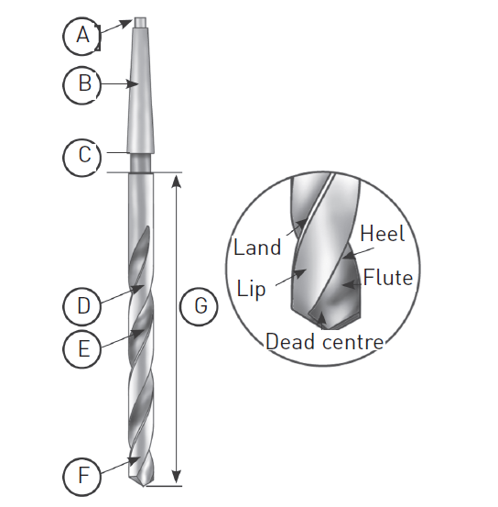
Parts of a drill bit
Figure 2.7: Taper-shank drill bit

Slide 15
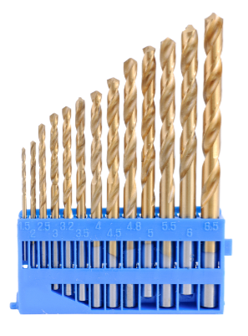
Types of drill bits
Figure 2.8: Different sizes of twist drill bits

Slide 16
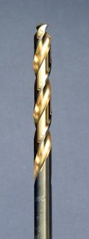
Types of drill bits
Figure 2.9: A titanium nitride bit

Slide 17
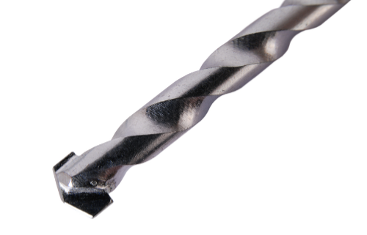
Types of drill bits
Figure 2.10: A masonry bit

Slide 18
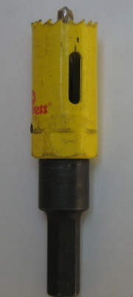
Types of drill bits
Figure 2.11: A hole saw

Slide 19
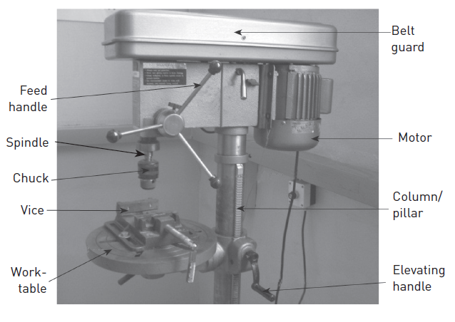
Parts of a drill press
Figure 2.12: A drill press

Slide 20
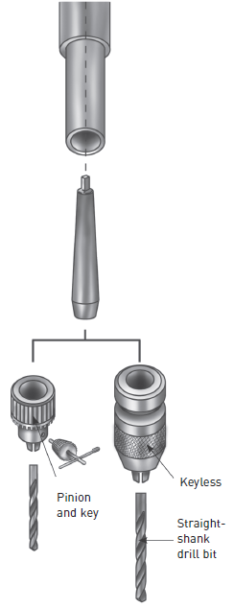
Drill-bit holding devices
Figure 2.13: Types of chucks

Slide 21
Drill-bit holding devices
Figure 2.14: Sleeves and sockets

Slide 22
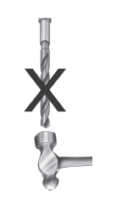
Drill-bit holding devices
Figure 2.15: Do not knock the bit with a hammer!

Slide 23
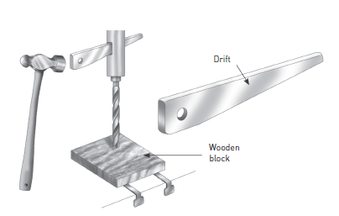
Drill-bit holding devices
Figure 2.16: Using a drift to remove drill bits and sockets

Slide 24
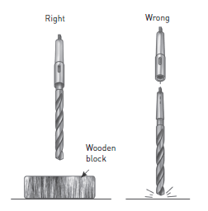
Drill-bit holding devices
Figure 2.17: Always use a wooden block when removing bits

Slide 25
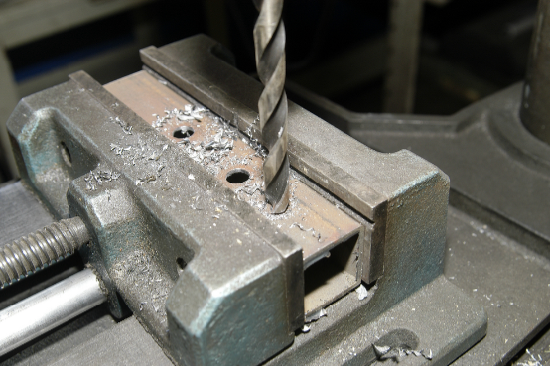
Drill-bit holding devices
Figure 2.18: Vice in position

Slide 26
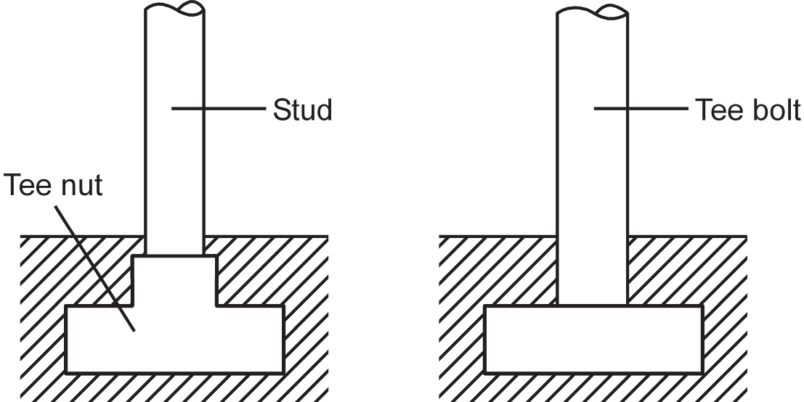
Clamping
Figure 2.19: T-nut and T-bolt

Slide 27
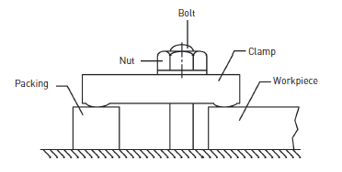
Clamping
Figure 2.20: How to use a clamp

Slide 28
Advantages of a drill press compared to a hand drill
Less effort is required to use.
A vice or clamp can be used to lock the workpiece in place.
Safer and more secure.
The angle of the spindle is fixed.
Holes can be drilled accurately and repetitively.
Speed changes.

Slide 29
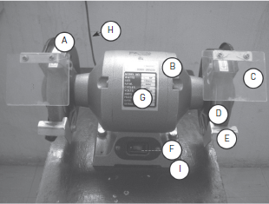
Bench grinders
A – Wheel safety cover
B – Motor
C – Spark shield
D – Grinding wheel
E – Tool rest
F – Motor control switch
G – Identification plate
H – Power cord
I – Machine base
Figure 2.21: Parts of a bench grinder

Slide 30
Bench grinders
Figure 2.22: Structure of the abrasive grit

Slide 31
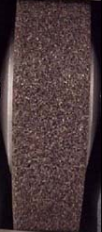
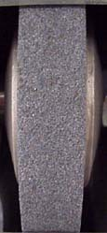
Bench grinders
Figure 2.23: Coarse grit
Figure 2.24: Fine grit

Slide 32
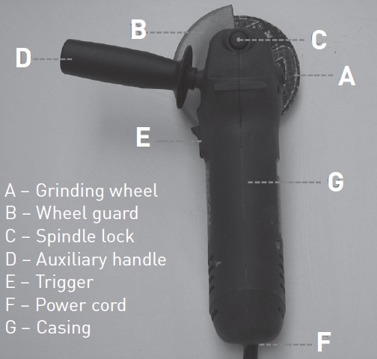
Angle grinders
Figure 2.25: Parts of an angle grinder

Slide 33
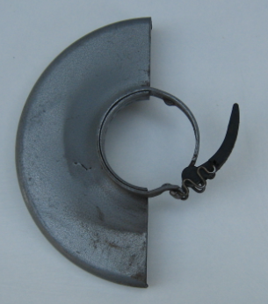
Angle grinders
Figure 2.26: Wheel guard removed from grinder

Slide 34
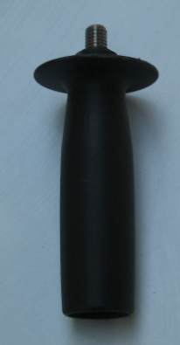
Angle grinders
Figure 2.27: Auxiliary handle

Slide 35
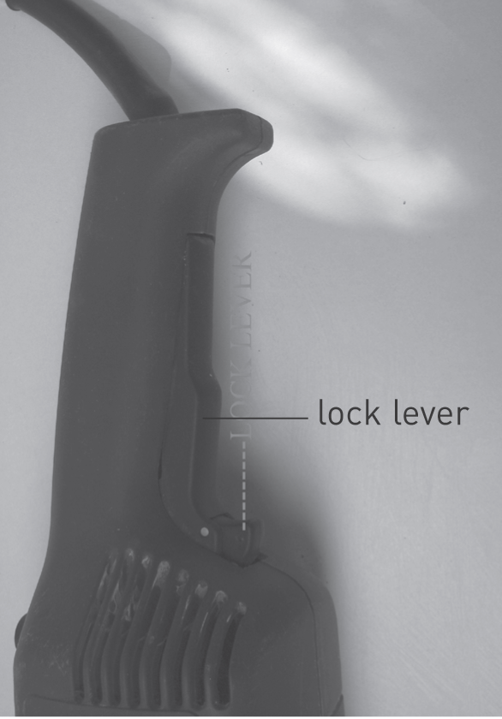
Angle grinders
Figure 2.28: Trigger
with lock lever

Slide 36
VIDEO: Angle grinder

Slide 37
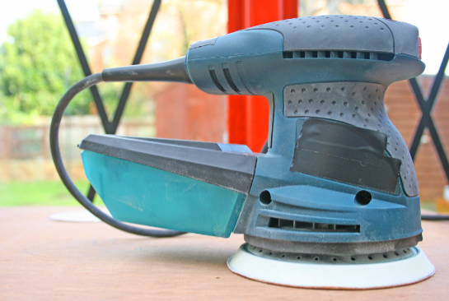
Orbital sanders
Figure 2.29: An orbital sander

Slide 38
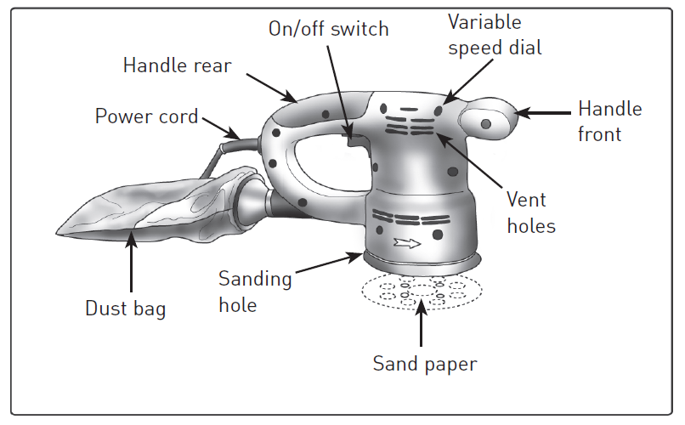
Orbital sanders
Figure 2.30: Parts of an orbital sander

Slide 39
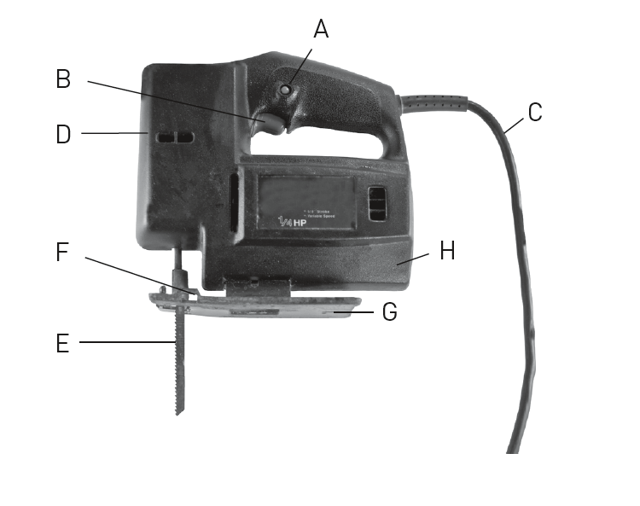
Jigsaws
A – Locking button
B – Operating switch
with speed controller
C – Main lead
D – Sight guard
E – Saw blade
F – Rollers
G – Saw shoe
H – Allen key holder
Figure 2.31: Parts of a jigsaw

Slide 40
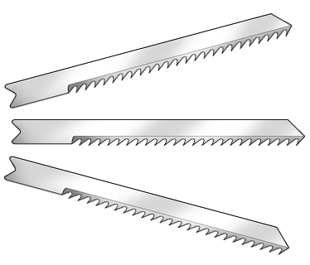
Jigsaws
Figure 2.32: Jigsaw blades

Slide 41
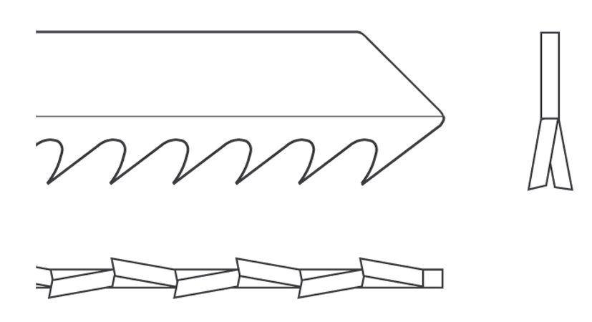
Jigsaws
Figure 2.33: Teeth milled, side set

Slide 42
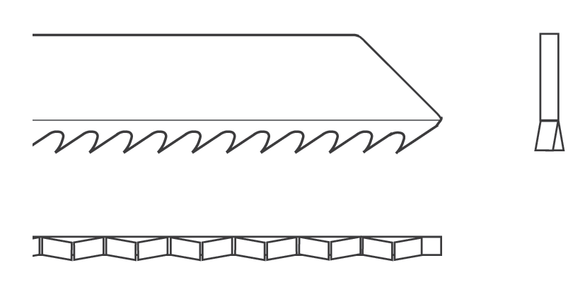
Jigsaws
Figure 2.34: Teeth milled, wavy set

Slide 43
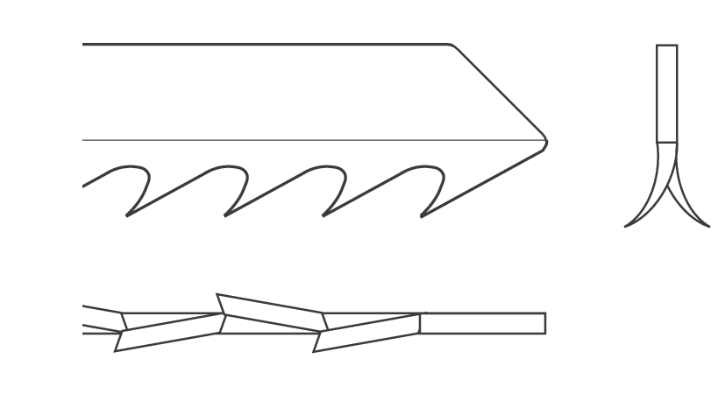
Jigsaws
Figure 2.35: Teeth ground, side set

Slide 44
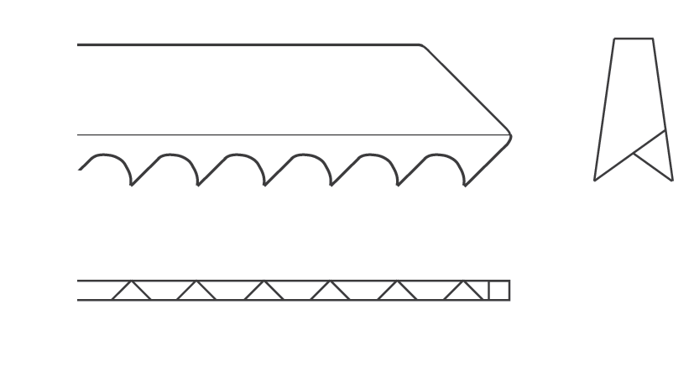
Jigsaws
Figure 2.36: Teeth ground, taper ground set

Slide 45
VIDEO: Jigsaw

Slide 46
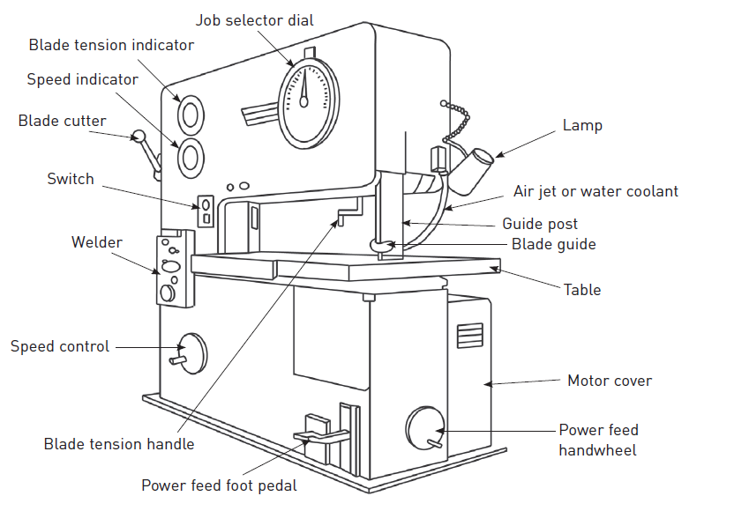
Bandsaws
Figure 2.37: Parts of a bandsaw

Slide 47
Selecting pneumatic tools
Advantages of pneumatic tools over other power tools
They are cheaper, safer and easier to maintain.
They can fit into small spaces.
They are safer to use ̶ is no danger of sparking / fire.
Higher power to weight ratio.

Slide 48
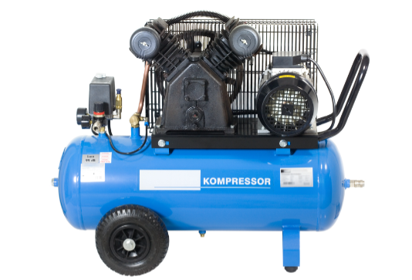
Compressors
Figure 2.39: A compressor

Slide 49
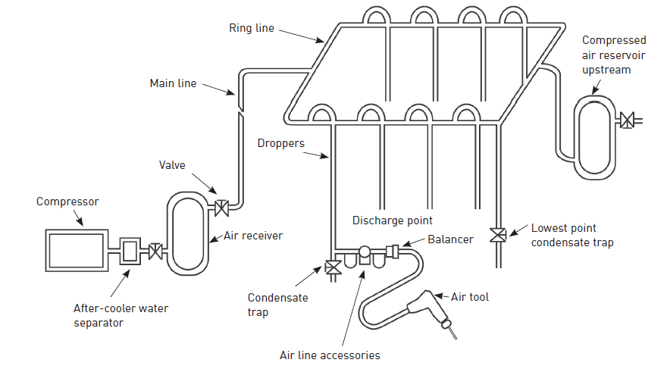
Compressed air distribution system
Figure 2.40:
A compressed
air distribution system

Slide 50
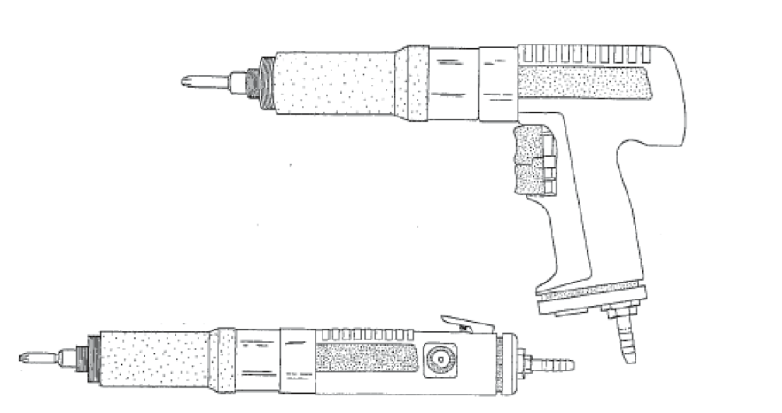
Pneumatic screwdrivers
Figure 2.41: Pneumatic screwdrivers

Slide 51
Pneumatic ratchet wrenches
Figure 2.42: A pneumatic ratchet wrench

Slide 52
Pneumatic impact wrenches
Figure 2.43:
A pneumatic
impact wrench

Slide 53
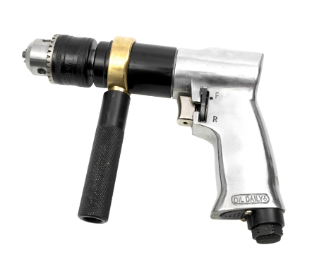
Pneumatic drills
Figure 2.44: A pneumatic drill

Slide 54
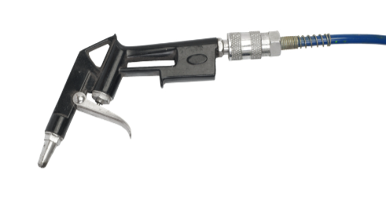
Pneumatic duster guns
Figure 2.45: A pneumatic duster gun

Slide 55
Pneumatic sanders and polishers
Figure 2.46: Parts of a pneumatic sander and polisher

Slide 56
Selecting hydraulic tools
Hydraulic tools use fluid power to do work.
The advantage of hydraulic machinery is that a large amount of power can be transferred through small tubes and flexible hoses.

Slide 57
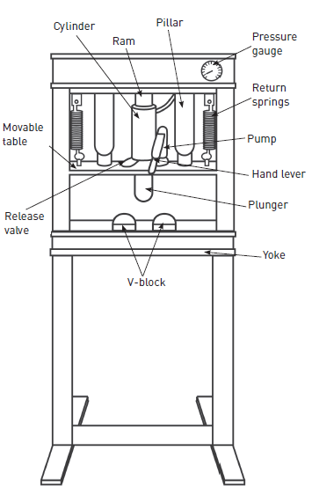
Hydraulic presses
Figure 2.49: Parts of a hydraulic press

Slide 58
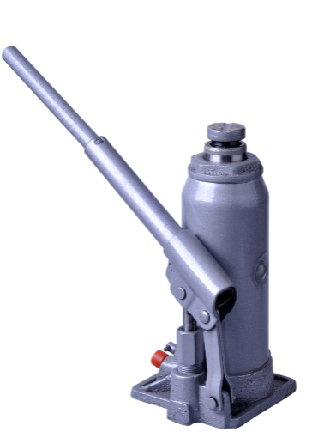
Hydraulic jacks
Figure 2.50: A bottle jack

Slide 59
VIDEO: Hydraulic jack

Slide 60
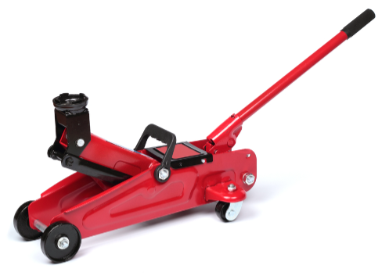
Hydraulic jacks
Figure 2.51: A trolley jack

Slide 61
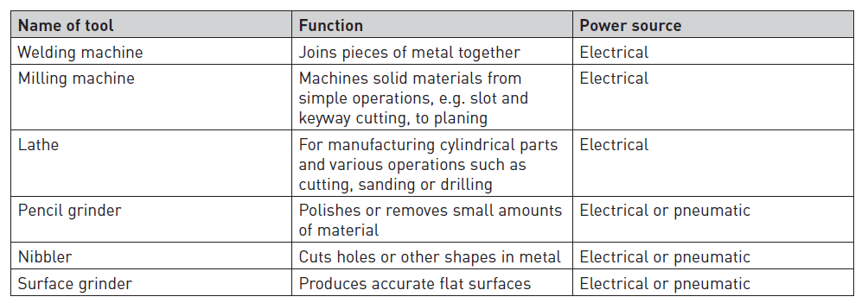
Other tools in a workshop
Table 2.1: Other tools found in a workshop

Slide 62
Using engineering power tools
Unit 2.2

Slide 63
Safety and engineering power tools
Figure 2.52: Damaged cables
Figure 2.53: Do not join cables like this

Slide 64
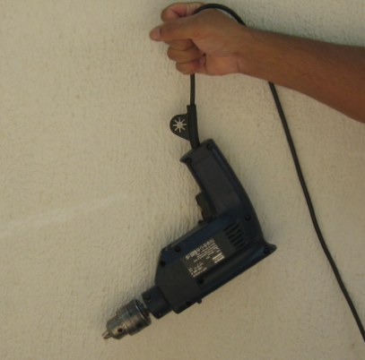
Safety and engineering power tools
Figure 2.54: Do not carry or hold a power tool by its cable

Slide 65
Safety and engineering power tools
Figure 2.56: Examples of personal protective equipment

Slide 66
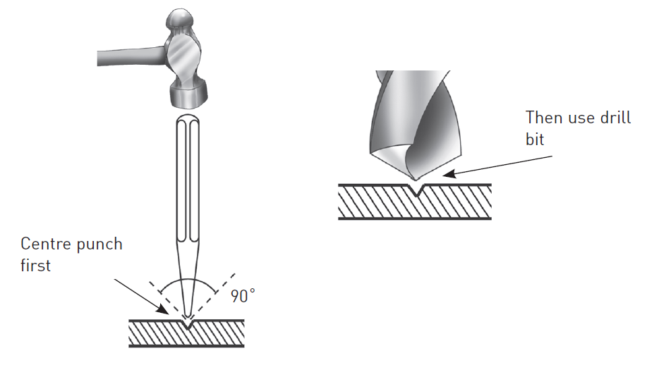
Using portable electric drilling machines
Figure 2.58: Punching a hole

Slide 67
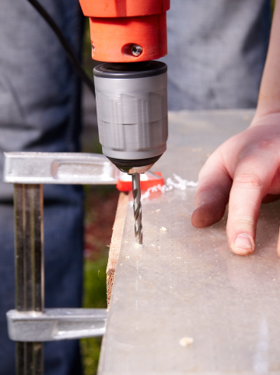
Using portable electric drilling machines
Figure 2.59: How to use
a drilling machine

Slide 68
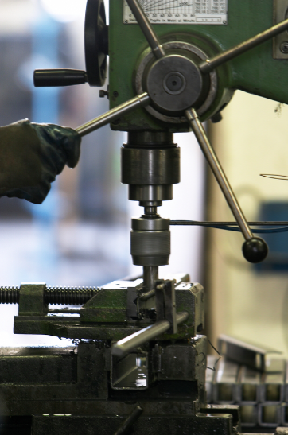
Using drill presses
Figure 2.60: How to use a drill press

Slide 69
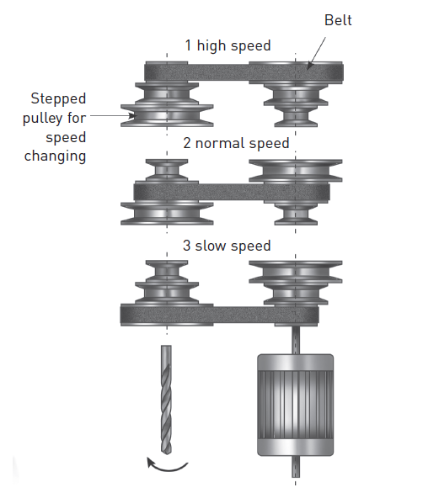
Using drill presses
Figure 2.61: How to change the belt position

Slide 70
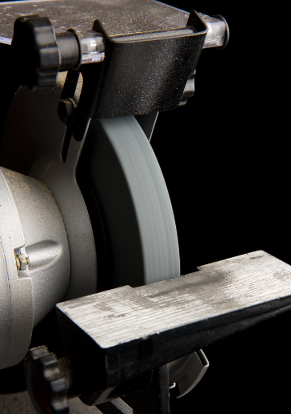
Using bench grinders
Figure 2.62: Position of tool rest

Slide 71
Using bench grinders
Figure 2.63: How to grind a piece of metal

Slide 72
Using bench grinders
Figure 2.64: Performing the ring test with the handle of a screwdriver

Slide 73
Using bench grinders
Figure 2.67: Dust masks

Slide 74
Using bench grinders
Figure 2.65: Spindle parts of a bench grinder

Slide 75
Using bench grinders
Figure 2.66: Mounting a grinding wheel

Slide 76
Using a bench grinder to sharpen a screwdriver
Figure 2.68: Aligning the blade against the grinding wall
Figure 2.69: Grinding the blade square

Slide 77
Using a bench grinder to sharpen a flat chisel
Figure 2.70: How to sharpen a flat chisel

Slide 78
Using a bench grinder to sharpen a flat chisel
Figure 2.71: Move the chisel from side to side

Slide 79
Using a bench grinder to sharpen a flat chisel
Figure 2.72: Check that the angle is correct

Slide 80
Using a bench grinder to grind a mushroom head
Figure 2.73: Grinding a mushroom head

Slide 81
Using a bench grinder to sharpen punches
Figure 2.75: Sharpening a centre punch to produce a 90° angle

Slide 82
Using a bench grinder to sharpen a twist drill bit
Figure 2.76: Standard point angle
Figure 2.77: Lip clearance angles

Slide 83
Using a bench grinder to sharpen a twist drill bit
Table 2.2: Guidelines for point angles and lip clearance

Slide 84
Using a bench grinder to sharpen a drill bit
Figure 2.78: Starting position showing 59° angle between the wheel and cutting lip

Slide 85
Using a bench grinder to sharpen a drill bit
Figure 2.79: Keeping the drill bit against the wheel

Slide 86
Using a bench grinder to sharpen a twist drill bit
Figure 2.80: Grinding from the lip to the heel

Slide 87
Using a bench grinder to sharpen a twist drill bit
Figure 2.81: A 59° drill gauge

Slide 88
Dressing grinding wheels
Figure 2.82: A loaded grinding wheel

Slide 89
Dressing grinding wheels
Figure 2.83: Huntington dresser

Slide 90
Dressing grinding wheels
Figure 2.84: Diamond dresser

Slide 91
Dressing a grinding wheel using a Huntington dresser
Figure 2.85: Sliding the dresser
along the tool rest

Slide 92
Dressing a grinding wheel using a Huntington dresser
Figure 2.86: Distance between
wheel and tool rest

Slide 93
Dressing a grinding wheel using a diamond dresser
Figure 2.87: How to use
a diamond dresser

Slide 94
Angle grinder safety
Figure 2.88: A chipped disc
Figure 2.90: A worn-out disc

Slide 95
Angle grinder safety
Figure 2.89: Never use the grinder if the wheel guard has been removed

Slide 96
Installing a grinding disc
Figure 2.91: Attach the disc flange
Figure 2.92: Lower the disc flange onto the spindle shaft
Figure 2.93: Insert the disc

Slide 97
Installing a grinding disc
Figure 2.96: Use the wrench to tighten the clamp nut
Figure 2.94: Screw on the clamp nut
Figure 2.95: Check for excessive play

Slide 98
Installing a grinding disc
Figure 2.97: Tighten the clamp nut

Slide 99
Installing a grinding disc
Figure 2.98: The correct positioning of the disc flange and the clamp nut

Slide 100
Using an angle grinder
Figure 2.99: How to cut a round pipe

Slide 101
Using an orbital sander
Figure 2.100: Variable speed switch

Slide 102
Using an orbital sander
Figure 2.101: Sanding disk

Slide 103
Using an orbital sander
Figure 2.102: Installing a sanding disk

Slide 104
Using a jigsaw
Figure 2.103: Always use
sharp blades

Slide 105
Using a jigsaws
Figure 2.104: Unplug the jigsaw before changing blades

Slide 106
Using a bandsaw
Figure 2.105: Ensure that the blade of a bandsaw is correctly adjusted

Slide 107
Using a bandsaw
Figure 2.106: How to use a bandsaw

Slide 108
Using a bandsaw
Table 2.3: Common causes of blade breakages and remedies

Slide 109
Using pneumatic tools
The use of pneumatic tools is similar to that of electric power tools.
Figure 2.107: A pneumatic hose with the correct fittings

Slide 110
Using hydraulic tools
Figure 2.108: Jack stands are used to support a vehicle

Slide 111
Using a hydraulic press
Figure 2.109: The operation of a hydraulic press

Slide 112
Caring for engineering power tools
Unit 2.3

Slide 113
Maintenance and care of power tools
A regular maintenance schedule and plan is extremely important.
Keep and refer to the maintenance manuals.
All power tools must have a logbook of use.
Handle and store with care.
Store in original storage box to protect from damage.
Store in clean, dry place.
Tools must be kept lubricated to prevent rusting.

Slide 114
Caring for drill bits
Learn how to sharpen drill bits to help cut costs.
Good-quality bits are expensive.
Keep them in a separate box or case to prevent damage.
Use a coolant to extend the life of the drill bit and to drill more quickly when drilling steel.

Slide 115
Caring for drill presses
Periodically lubricate:
The gear-and-rack table elevation mechanism.
The splines (grooves) in the spindle.
The rack (teeth on the quill).
Ensure that the base is properly secured to the workshop floor.
Keep table and column clean at all times.

Slide 116
Caring for grinding wheels
Check new wheels for any transport damage.
Store carefully on wooden racks to prevent damage (use partitions to prevent wheels from tipping over).
Place small wheels in boxes or drawers to prevent them from bumping against one another.
Protect storeroom from moisture and extreme temperatures or vibration.
Do not store resinoid-bonded grinding wheels for longer than two to three years.
Vitrified-bonded grinding wheels can be stored indefinitely.

Slide 117
Caring for jigsaws and bandsaws
Always keep saws clean.
Brush air vents and dust extraction port.
Wipe the casing.
Do not use caustic cleaning solutions to clean the plastic housing.
If excessive sparks are generated, check the carbon brush.
Replace damaged or worn-out components with genuine parts.
Lubricate the blade support roller with light machine oil.

Slide 118
Caring for pneumatic tools
A programme of air-tool maintenance should cover the following:
Ensure air supply is maintained at the required pressure.
Regularly check and refill the lubrication.
Check for any signs of damage.
Check that the proper attachments or accessories are used.
Do not drag tools by their hoses.

Slide 119
Caring for hydraulic tools
Proper maintenance of jacks is essential for safety.
Lubricate all jacks regularly.
Inspect each jack according to the following schedule:
Used at one site ̶ at least once every six months.
Used outside the workshop ̶ when sent out and when returned.
Abnormal loads ̶ before and immediately after use.

Slide 120
Checking the power supply
Power to electrical tools is supplied by means of a three-core cable connected to a three-pin plug.
Figure 2.110: Terminal arrangement for plugs

Slide 121
Inspecting power tools for defects
Figure 2.111: A damaged power cable

Slide 122
Inspecting power tools for defects
Figure 2.112: The use of adaptors may result in a fire

Slide 123
Lubricating power tools
Lubricate according to the manufacturer’s recommendations.
A regular lubrication schedule ensures longer life.
Figure 2.113: A grease gun

Slide 124
Lubricating power tools
Figure 2.114: An oil can

Slide 125
Summative assessment
Complete the Summative assessment on page 105 of the Student’s Book.

